Slide 1


micro:bit programming tutorial
Lesson 12
micro:bit basic lesson 12“The game of Summer”
Yahboom micro:bit tutorial

Slide 2
micro:bit programming tutorial
Part1
Part 2
Part3
Part 4
Part 5
Learning goals
Preparation
Search for blocks
Combine blocks
Have a try
Yahboom micro:bit tutorial

Slide 3
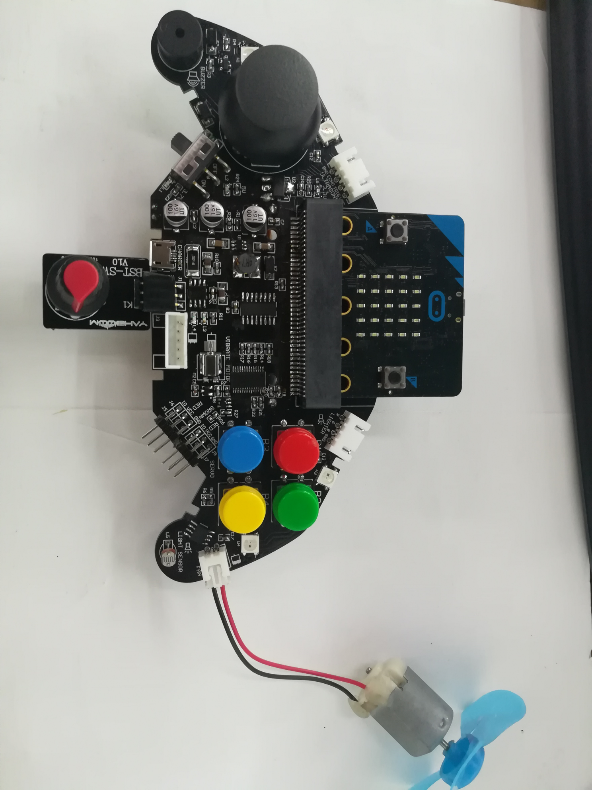
micro:bit programming tutorial
Part1
Plug in the knob potentiometer and fan, download the program, twist the potentiometer, and the speed of the fan will be adjusted accordingly. However, be aware that the fan cannot be touched by hand when it is turning.
Yahboom micro:bit tutorial

Slide 4
micro:bit programming tutorial
Part2
Hardware：
● 1 X micro:bit Game Handle
● 1 X Micro USB Cable
Yahboom micro:bit tutorial

Slide 5
micro:bit programming tutorial
Two programming methods
Part2
1.Online: Connect Micro:bit to the computer via USB cable, and the computer will pop up a U disk and click the URL in the U disk to enter the programming interface.Enter this URL https://github.com/yahboomtechnology/ghbitlib to get the package named GHBit.
2.offline：Open micro:bit offline programming software and add GHBit package.Click on "Advanced" and select "Add Package".Enter this URL https://github.com/yahboomtechnology/ghbitlib to get the package named GHBit.
Note: If you already have a GHBit package, you don't need to add it repeatedly.
Yahboom micro:bit tutorial

Slide 6
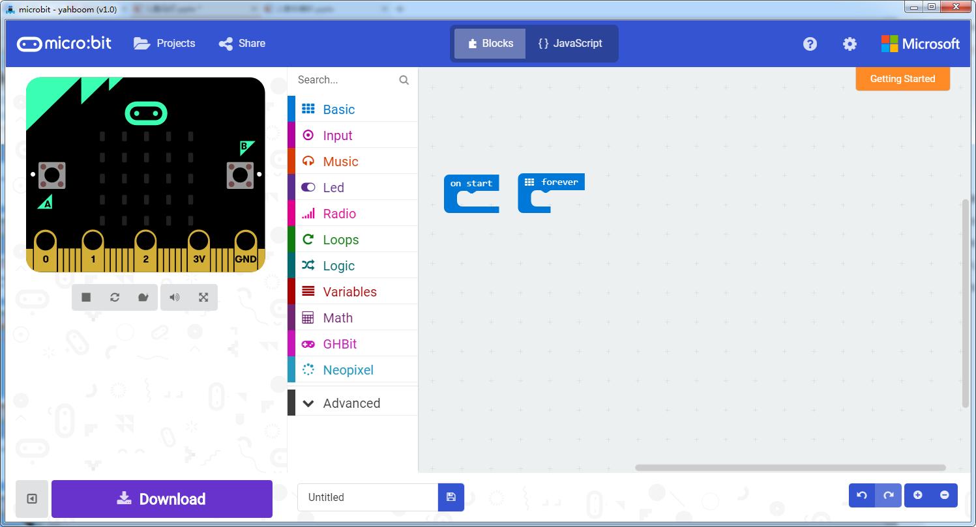
micro:bit programming tutorial
Programming interface
Part3
Yahboom micro:bit tutorial

Slide 7
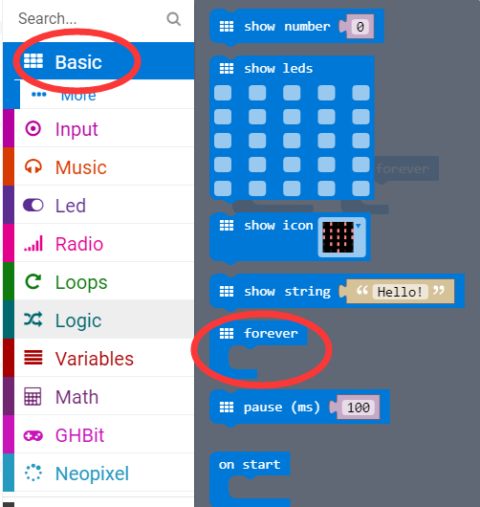
micro:bit programming tutorial
Part3
Start programming
The “forever” building block means that when the micro:bi Game Handle is turned on, the blocks in “forever” are repeatedly executed.
Yahboom micro:bit tutorial

Slide 8
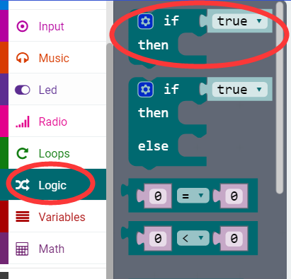
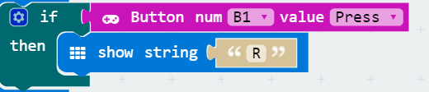
micro:bit programming tutorial
Part3
If a value is true, then do some statements.
For example: If the B1 button of the handle is pressed, the dot matrix display character R is executed. If the B1 button is not pressed, it will not be executed.
Yahboom micro:bit tutorial

Slide 9
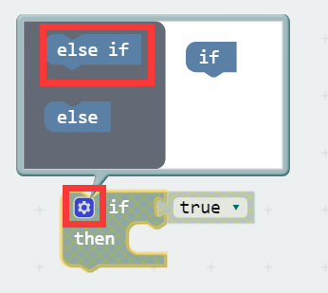
micro:bit programming tutorial
Part3
When there are many choices, you can click on the pinion above. Drag the "else if" on the left to the bottom of the "if" on the right, and click on the pinion again.
Yahboom micro:bit tutorial

Slide 10
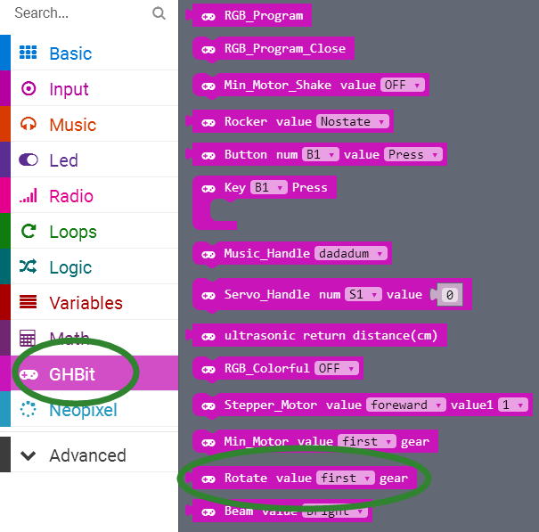
micro:bit programming tutorial
Part3
Set the angle of the knob potentiometer.
Yahboom micro:bit tutorial

Slide 11
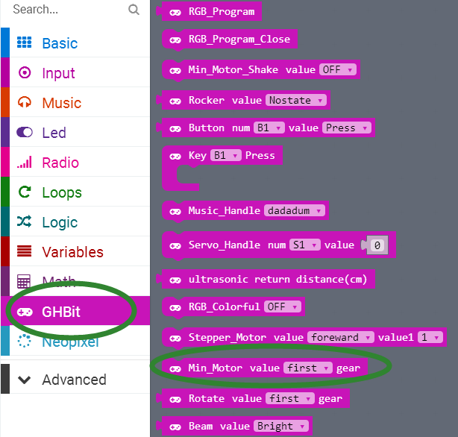
micro:bit programming tutorial
Part3
This is a fan speed control block that can change gears to adjust the wind speed.
Yahboom micro:bit tutorial

Slide 12
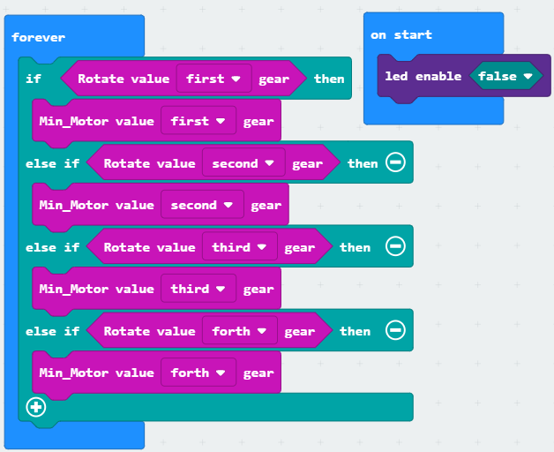
micro:bit programming tutorial
Part4
!Note:
Because the adjustable knob uses the P3 pin, it is multiplexed with the pin of the micro:bit dot matrix. So we need to turn off the LED during initialization.
This is the complete building block for this course, let's download it to the micro:bit Game Handle.
Yahboom micro:bit tutorial

Slide 13
micro:bit programming tutorial
Part5
Do you learn the course today?
If you learn to do it, give yourself a top quack.
Now give you a homework assignment.
Write a program that twists the potentiometer and the small speakers emit different tones.
Start your little brain. Try it.
Yahboom micro:bit tutorial

Slide 14
micro:bit programming tutorial
micro:bit
Thanks for watching！
Yahboom
Yahboom micro:bit tutorial

